Slide 1

Website Development: Lesson 5
Facilitated by: Titus Kariuki
Notes:
Web development kahoot

Slide 2
Agenda
1. Ice breaker
2. Recap
3. First Project!!

Slide 3

Ice Breaker!
Most difficult concept we have talked about so far
Do you prefer virtual or in-person learning?

Slide 4

Congratulations!
You now know the basics of HTML and CSS code. Time to put your skills to the test 🤔

Slide 5

Recap
HTML
Used for creating the web page structure
CSS
Used to design the looks of a page

Slide 6
Recap - Tags
What it does | Opening Tag | Closing Tag
Open the webpage | <html> | </html>
Opens the head section | <head> | </head>
Title | <title> | </title>
Heading | <h> | </h>
Opens the body section | <body> | </body>
Paragraph | <p> | </p>

Slide 7
Recap - Text Tags
What it does | Opening Tag | Closing Tag
Highlighter | <mark> | </mark>
Underline | <ins> | </ins>
Superscript | <sup> | </sup>
Subscript | <sub> | </sub>
Small | <small> | </small>
Italics | <i> | </i>
Bold | <b> | </b>

Slide 8
Recap - Lists, Images
What it does | Opening Tag | Closing Tag
Ordered List | <ol> | </ol>
Unordered List | <ul> | </ul>
Image | <img alt = “Alternative Text src = “image URL” width = “” height = “”>

Slide 9
Recap - CSS & iFrames
body
{
background color: insert any color here;
}
head
{
background color: insert any color here;
}
h1
{
color: insert a color here;
Text-align: left/center/right/justify;
}
h1
{
font-family: insert any font here;
font-size: insert any size here (e.g., 20px);
}
IFRAMES
<iframe src="url" title="description"></iframe>
Resource: W3Schools

Slide 10
Project 1 - ASP Website
Using all previous lessons, design a webpage that talks about what you do during your After-School Program.
(Don’t worry if you get stuck, this is just practice. :)
Notes:
https://codebeautify.org/pantone-to-hex-converter
https://www.w3schools.com/css/default.asp

Slide 11
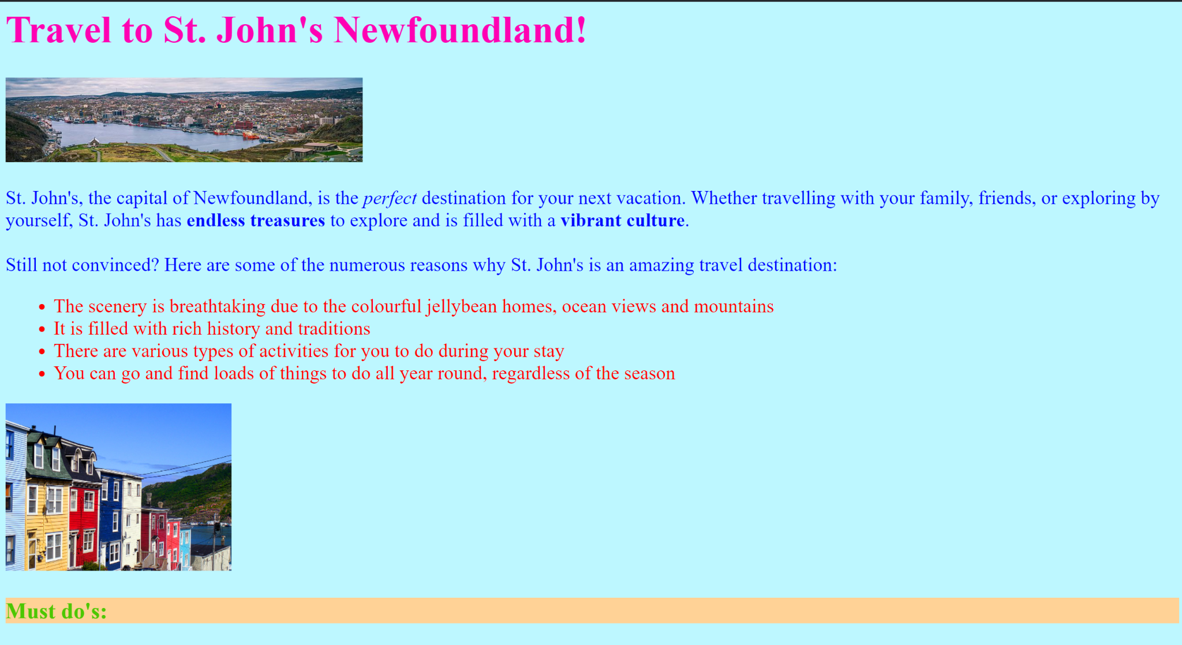
Project 1 - Travel Webpage
Using all previous lessons, design a webpage for a destination you would like to travel to. (Don’t worry if you get stuck, this is just to practice your skills :) )
Notes:
https://codebeautify.org/pantone-to-hex-converter
https://www.w3schools.com/css/default.asp

Slide 12

Questions?

